Slide 1
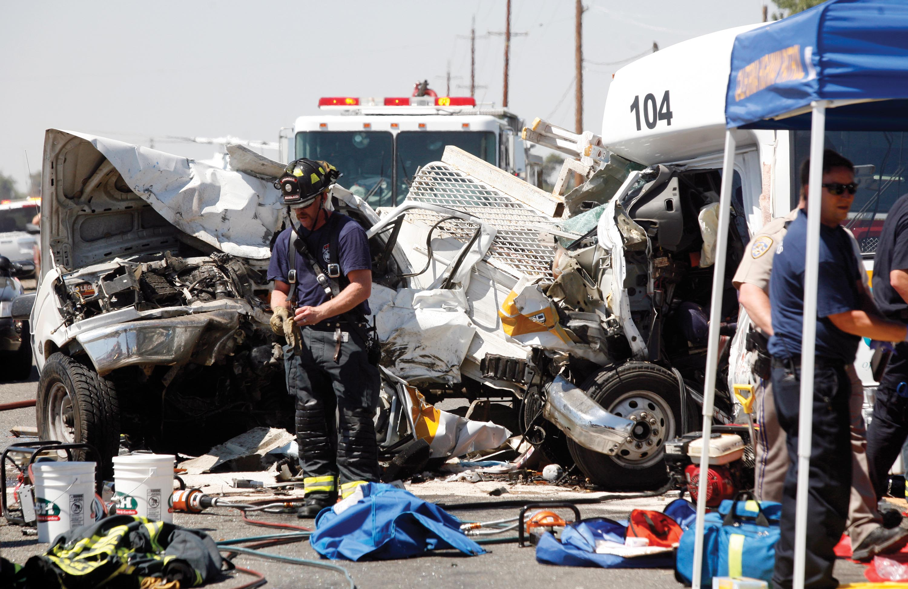

Avoiding a Head On Collision with Delivery
Provided by

Slide 2


Presenters
Sara Gibson, CRM – Risk Control Consultant
Adam Wilberding – Strategic Safety Director of Loss Control Services
Notes:
Sara and Adam to introduction themselves.

Slide 3

Deliveries – What are the risks?
Food Safety and Quality
  Risk of customer getting sick
  Reputational risk if food isn’t served as intended (e.g. soggy, not right temperature), or if it looks like the delivery driver has tampered with their food
Crime
  Delivery drivers may be targeted because thieves know they could be carrying large sums of cash
Notes:
Sara Gibson slide

Slide 4
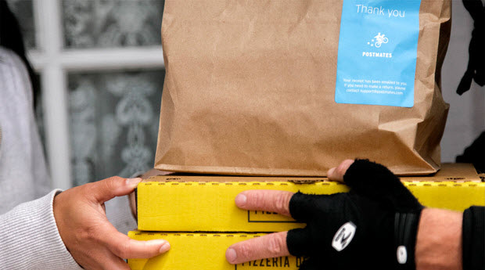

Deliveries – What are the risks?
Slips/Trip/Falls
  Customers’ homes could have hazards such as a garden hose laying across a pathway, uneven walking surfaces, or slick surfaces
Workplace Violence
  Unhappy customers
  Confrontations over masks
Driving
Notes:
Sara Gibson slide
Slip/trip/falls according to OSHA contributes around 12-15% of all workers compensation costs, and cost around $40k per incident; so this is a significant risk that you should educate your driver’s about, especially since you will have no control over the premises where they make deliveries, so their attention and care to this issue is paramount
Workplace violence – most of the time people are easy to work with, but unhappy customers can sometimes take out their frustration on the delivery driver; remind employees not to take a difficult customer’s behavior personally, to listen to what the customer is telling you and acknowledge them; and let them know you’ll report the error to your supervisor who will contact them with a solution to the problem (in all likelihood the driver will not be able to provide a solution right away); we’ve been hearing from many of our clients personally and have seen on the news that there are confrontations escalating when an employee asks a customer to wear a mask and the customer refuses to do so; it’s crucial to train your staff on all health and safety measures your implementing and why, and how to politely request customers wear a mask; for example, “our policy is to require all customers wear a mask, can I provide one to you?” If the guest refuses, communicate to staff what they should do next; we recommend not asking non-management staff to refuse service or remove customers, a manager should handle this; and if necessary, security or law enforcement should handle removing the patron
Driving – deliveries typically involve driving, and having employees drive as part of their job duties poses significant risks for employers; not just employee safety/workers comp risks, but also 3rd party liability risks;

Slide 5
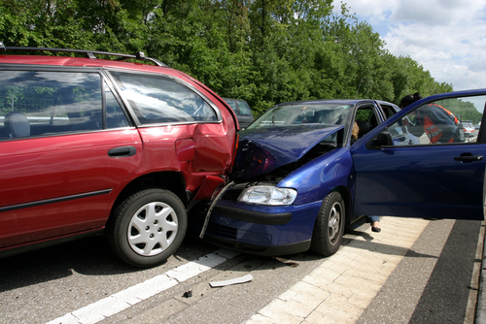
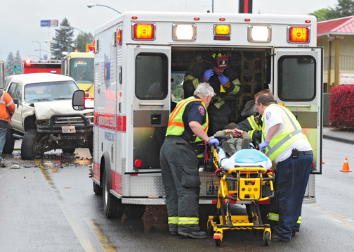
Understanding the Risk - Statistics
Motor vehicle crashes are the No. 1 cause of work-related deaths; account for 24% of all fatal occupational injuries.^{1 - CDC}
On-the-job crashes are costly to employers^{2 - NHTSA}
  Average $24,500 per property damage crash
  Average $150,000 per injury crash
  Fatality involved - average cost is $500,000+
¹CDC. (2011, April 29). Occupational highway transportation deaths—United States, 2003–2008. MMWR, 60(16), 497–502.
²U.S. Department of Transportation, National Highway Traffic Safety Administration. (2005, August). The Economic Burden of Traffic Crashes on Employers-Costs by State and Industry and by Alcohol and Restraint Use (Publication No. DOT HS 809 682).
Notes:
Adam slide
Motor vehicle crashes are the No. 1 cause of work-related deaths and account for 24% of all fatal occupational injuries.
On-the-job crashes are also costly to employers. On average, property damage crashes cost $24,500, personal injury crashes cost $150,000 and fatalities are half a million plus.

Slide 6

Understanding the Risk - Costs
Direct vs Indirect Costs of Accidents
  Direct Costs - equated with visible part of iceberg (~20%)
  Indirect Costs - equated with hidden part of the iceberg below water’s surface; (~80% or 4-10x direct costs)
Notes:
Adam slide
Direct vs indirect costs.
Many people do not realize how much accidents really cost, and, in fact, many expenses are not always obvious.
Direct and indirect costs can be better understood by the iceberg comparison. Total accident costs can be compared to an iceberg.

Slide 7
Understanding the Risk – Costs
Direct
  Claim deductibles (both auto liability and workers’ compensation claims)
  Medical expenses
  Loss time payments
  Vehicle repair/replacement
  Civil liability, litigation, settlements/award
Indirect
  Administrative and supervisory expenses/time
  Negative public image and loss of business
  Loss of skill/efficiency - slowed production
  Failure to meet customer demands
  Re-entry and retraining of injured employees.
  Overtime pay and employee replacement (to cover work of missing employee)
  Increased insurance premiums
Notes:
Here we have a handful of examples for each category of loss.
People often try to minimize the costs of accidents by saying they are covered by insurance.
Insurance, however, covers only a portion of the total accident cost.
It is clear that directly and indirectly, accidents reduce profitability.

Slide 8

Understanding the Risk – Litigation
In cases where employees were involved in crashes while using cell phones, juries are generally motivated to award large verdicts.
*Employer Liability and the Case for Comprehensive Cell Phone Policies; The National Safety Council, 2012.
Notes:
Adam slide
In cases where employees were involved in crashes while using cell phones juries are generally motivated to award large verdicts.
We’ll look at some of those on the next slide.

Slide 9
Understanding the Risk – Jury Awards
$24.7M – Commercial Transportation Company, 2008 crash in Missouri
$21.6M – Technology Company, 2007 crash in Florida
$21M – Soft Drink Beverage Company, 2010 crash in Texas
$8.7M – State of Illinois, 2007 Crash in Illinois (State Trooper)
$5.2M – Paper Company, 2007 Crash in Georgia
$4.1M – Electrical Contracting Company, 2006 Crash in Illinois
$4M – Prince George’s County, 2009 Crash in Maryland (Police Officer)
$2M – Law Firm, 2004 Crash in Virginia
$1.75M – Car Dealership, 2007 Crash in Florida
$1.5M – State of Hawaii, 2001 Crash in Hawaii (Teacher)
$1.45M – City of Palo Alto, 2006 Crash in California (City Worker)
$1M – Transportation Company, 2013 Crash in Ohio
Notes:
Here is a sampling of jury verdicts involving distracted drivers ranging from 24.7 million down to 1 million. Notice the diversity of organizations involved. This affects all of us regardless of work performed, job title or employer.

Slide 10
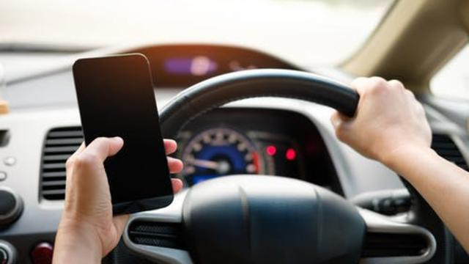
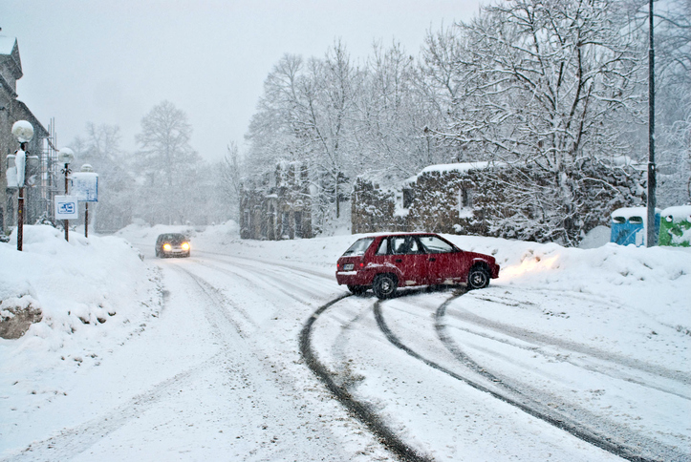
Understanding the Risk –
Common Causes of Accidents
Distracted Driving - #1
  Texting
  Watching videos or reading
  Eating
Aggressive Driving
  Speeding
  Brake checking
  Cutting off other drivers
Adverse Weather Conditions
  Rain
  Snow
  Fog
Notes:
Sara Gibson slide
Distracted driving is the leading cause of car accidents, and is activity that diverts the driver’s attention from driving; but using mobile devices (texting/using social media) is the most alarming distraction. Sending or reading a message takes around 5 seconds on average, and while that doesn’t sound like a long time, if you’re driving at 55mph you’d drive the length of an entire football field without looking at the road
Aggressive driving includes behaviors such as running red lights, speeding, cutting off other drivers or boxing the in, tailgating, using obscene gestures; these behaviors pose a serious risk, and to put it in perspective, the University of Hawaii did a research study on aggressive driving/emotionally impaired driving which found that aggressive driving kills approx. two to four times more people than drunk driving
Adverse weather conditions can affect roadways in multiple ways; such as causing slickness, decreasing roadway capacity (e.g. debris from winds, snow accumulation), disrupting traffic signal timing, and reducing visibility (e.g. rain, snow, fog). No matter how much driving experience or knowledge you have, it’s critical to never drive faster than what is safe for the current conditions on the roads; additionally, vehicles need to be properly serviced (e.g. tire treads cannot be worn down), drivers should leave more space than usual between vehicles, drive defensively, and allow extra time to get to their destination – when giving est. delivery times to customers, it’s important to keep this in mind when there are adverse weather conditions

Slide 11
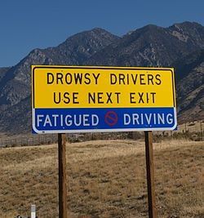
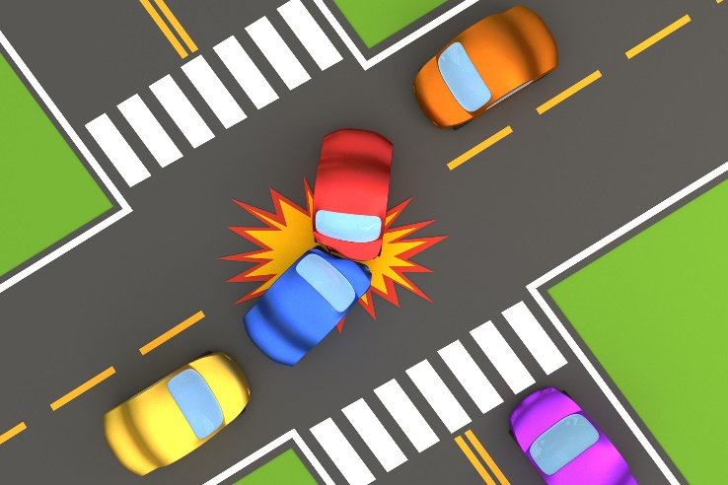
Understanding the Risk –
Common Causes of Accidents
Alcohol and Drug Impaired Driving
Fatigued Driving
  Can result when you don’t get enough sleep or don’t get quality sleep
Improper Lane Changes, Backing & Turns
Notes:
Sara Gibson slide
Alcohol and drug impaired driving slows driver’s coordination, judgment, and reaction times; certain drugs can also make drivers more aggressive and reckless. Ensure you have a drug free workplace policy and that employees are educated on the risks of impaired driving and what their role is; additionally, ensure employees and supervisors know who to report to and what the procedures are if they suspect someone of being impaired at work.
Fatigued driving can impair your driving similar to alcohol impairment. Fatigued drivers sometimes nod off, can react more slowly to changing road conditions, make poor decisions, and/or experience “tunnel vision”. Some ideas to combat this are to encourage self-reporting, implement policies that set overtime limits and maximum allowable consecutive shifts, and providing employee training on sleep health and fatigue management
Improper lane changes, backing & turns when people don’t follow traffic signals, don’t get into the proper lane to make a turn, and/or don’t beck blind spots, accidents happen. Delivery drivers often go to areas they’re unfamiliar with or have never driven, so it’s key that they look out for traffic signs. Additionally, drivers always need to obey right-of-way when making a turn, and ensure they’re checking blind spots.

Slide 12

Minimizing the Risk –
What can you do?
Techniques to Reduce Accidents and Injuries
Management leadership
Engineering controls
  Physical changes or enhancements
Administrative controls
  Policies, programs or education
Notes:
Sara Gibson slide
Now that we’ve reviewed they key risks associated with deliveries, for the rest of the webinar we’ll focus on loss control solutions for the risks we’ve outlined. There are different controls that can be implemented, some are engineering controls/physical changes (e.g. ensuring vehicles are safe to drive, wearing non-slip footwear, proper delivery containers); while others are administrative controls (educating employees, creating written policies), and we’ll review examples of both in more detail; but we also wanted to point out that these controls can only take you so far, it’s imperative to create a strong safety culture throughout the organization and have everyone in the organization buy in from the top down and hold each other accountable. The policy does no good if no one is following it.

Slide 13

Minimizing the Risk –
Management Leadership
Ownership/senior management commitment
Build and maintain culture of accountability
Set standards and hold team members to them
Reward for behaviors you want; discipline for those you do not want
Notes:
Adam slide
Ownership/senior management commitment – do you walk the talk? If not, team dismisses the importance of subject.
Build and maintain culture of accountability – establish clear roles and responsibilities. Communicate them to everyone.
Set standards and hold team members to them - Encourage that team members hold each other accountable.
Reward for behaviors you want; discipline for those you do not want. Avoid constant negative focus. However, be sure to consistently apply practices. OSHA/MIOSHA look for patterns of behavior from management when evaluating culture/safety program. Juries will do the same.

Slide 14
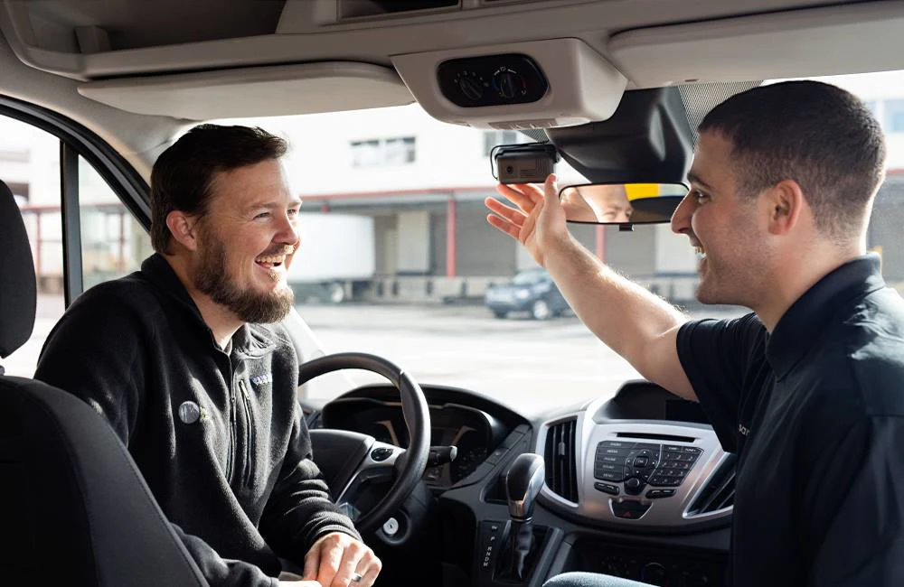
Minimizing the Risk –
Engineering Controls
Company vs Personal Vehicles for Delivery
Technology - Telematics / Dash Cams
  Monitor speed and location
  Monitor driver behaviors (e.g., distracted driving, tailgating, rolling stops, harsh driving)
  Coach employees in real-time with preventative in-vehicle alerts.
  Exonerate innocent employees.
Notes:
Adam slide
More control over vehicle maintenance – service and repairs - when company owned.
Telematics and dash cams make a big difference in driver behavior.
This technology uses embedded artificial intelligence (AI) and g-force accelerometers. They detect and audibly alert drivers to high-risk behaviors and incidents in real-time.
Substantial reduction in risky driving events, cell phone use, and traffic collisions. Testimonials abound.
Don’t overlook these devices as great solutions.
Carriers, more and more, are covering the costs of telematics when policy is placed with them… so, check with your carrier.

Slide 15
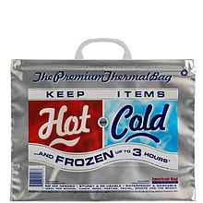
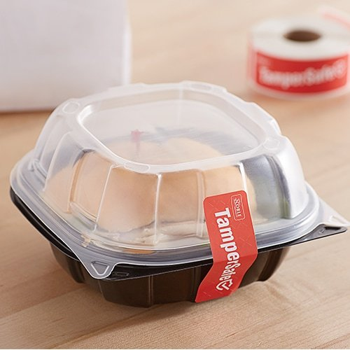
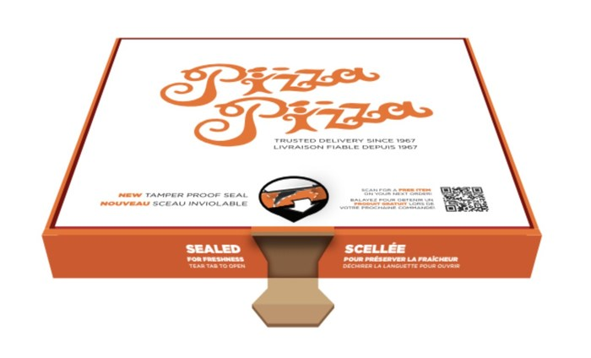
Deliveries – Engineering Controls
Use tamper evident packaging
Consider wrapping containers holding anything liquid to prevent spills
Notes:
Sara Gibson slide
To make customers feel comfortable their food hasn’t been tampered with between when it was finished being prepared in the kitchen to when it’s delivered at their door, consider using tamper evident food packaging; it also promotes food safety by preventing airborne contaminants from reaching prepared foods
To ensure food is delivered at the correct temperature and is served as intended, consider using thermal or insulated bags that are designed to keep hot food hot and cold/frozen food cold
To prevent spills – which can distract drivers and ruin the food the customer ordered – consider wrapping containers holding anything liquid to prevent spills

Slide 16
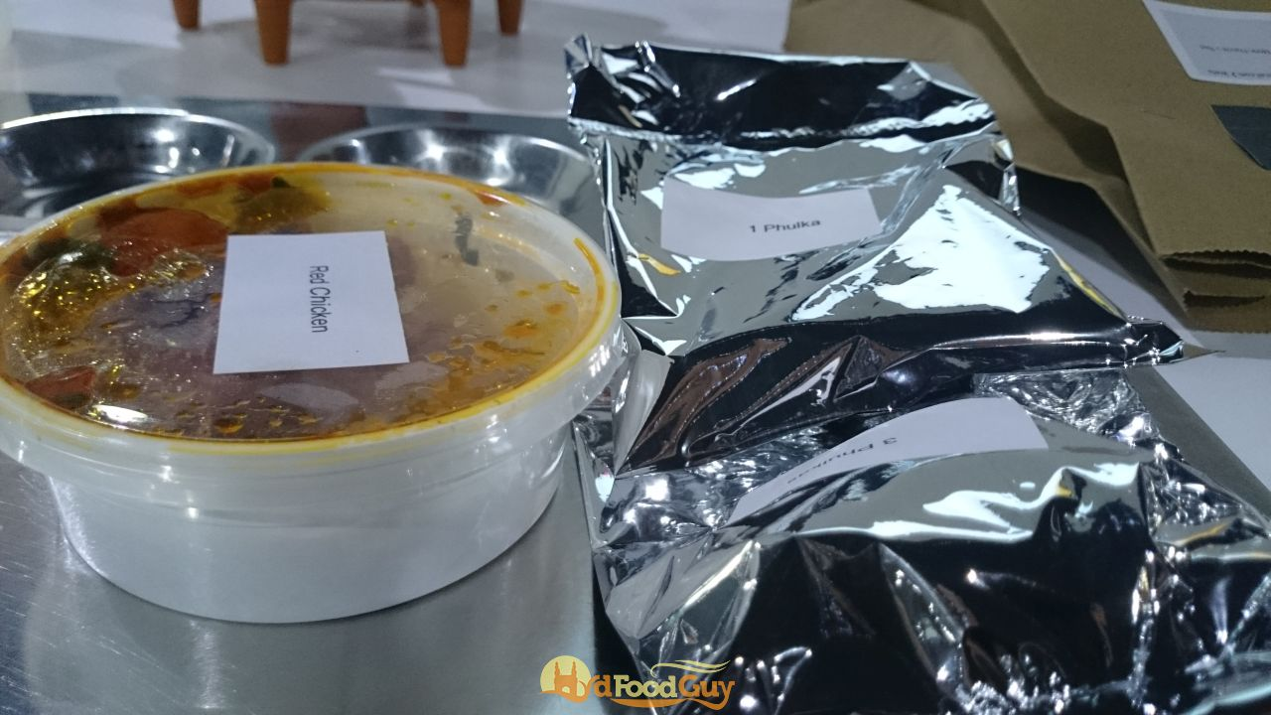
Deliveries – Administrative Controls
Create a written policy, consider including:
  Require drivers make frequent deposits
  Set a delivery zone limit
  Set a time limit for how long food can sit before being delivered
  Specify how food should be transported
Notes:
Sara Gibson slide
We recommend creating policies & procedures for food deliveries and training staff on what they are and why they’ve been implemented; the policies should be designed to guide staff through the delivery process, and to reduce common risks associated with deliveries that we discussed earlier; this can be especially helpful for new hires who may not have the key steps memorized yet
Requiring drivers make frequent deposits or limiting the number of deliveries they make on a single trip can ensure they never have a large sum of cash on hand;
Setting a delivery zone limit can ensure that food can stay warm/cold and reduce drive time for your delivery drivers;

Slide 17
Minimizing the Risk –
Administrative Controls
Create a Written Fleet Safety Auto Program
Key items to include:
  Vehicle use agreements
    Company vehicle use agreement
    Personal vehicle on company business use agreement
  Mobile device use policy
    Create a specific policy statement for this risk and require drivers to sign an acknowledgement that they read it
  Pre-screening/driver selection
    Employees with poor driving records expose your organization to potentially significant liability
Notes:
Sara Gibson slide

Slide 18
Minimizing the Risk –
Administrative Controls
Create a Written Fleet Safety Auto Program.
Key items to include - continued:
  Driver training and continuing education
    Safety meetings
    In-house/in-person trainings or online training modules
  Vehicle maintenance and inspections
    Use checklists
  Crash procedures and reporting forms
    Educate employees on the steps they need to take after a crash
    Create a vehicle accident form designed to gather all the pertinent information and ensure employees have access to it
Notes:
Sara Gibson slide

Slide 19
Minimizing the Risk –
Administrative Controls
Driver Record Monitoring:
  Pre-employment screens
  Periodic checks (i.e., annually) and monitoring (i.e., real time).
  Sources for driving records (i.e., motor vehicle record):
    Insurance agent/broker – GO / NO GO
    Michigan Secretary of State Subscription Service ($11/record)
    Third-party solutions such as iiX (https://www.verisk.com/iix/)
Notes:
Adam slide

Slide 20
Minimizing the Risk –
Administrative Controls
Education vs Training:
  Education to form beliefs (Why)
  Training to form behaviors (What, When, Where and How), which leads to habits
  Shorter duration and more frequent; 7 times.
Appropriate Curriculum:
  Distracted driving awareness and dangers of cognitive distraction (even with hands-free devices)
  Defensive driving
  Vehicle inspection (e.g. tires) and operation (i.e., proper mirror adjustments, etc.)
Notes:
Adam slide
Education and training are two distinct things but are often used interchangeably.
For our purposes, we draw out distinct differences between them and how they work together.
DDA Facts - Consider research findings showing that hands-free, voice-to-text technology still allows cognitive distraction. Such as the brain is distracted for up to 23 seconds afterwards and drivers use voice to text technology. Drivers miss up to 50% of the visual images in their driving picture. The mind is simply too distracted to process visual data input over auditory input.

Slide 21
Minimizing the Risk –
Administrative Controls
Appropriate Curriculum – continued:
  Slip/Trip and Fall Prevention
    Hazard identification and correction
    Technique (i.e., penguin walk)
    Footwear (i.e., Shoes for Crews and Yaktrax style ice grips)
  Workplace Violence Prevention
    How to deal with difficult people
    De-escalation techniques
    Delivery procedures
Notes:
Adam slide

Slide 22
Minimizing the Risk –
Administrative Controls
Reporting and Investigation:
  Written forms to collect facts from employee(s), witness(es), and supervisor(s)
  Management investigation of all incidents (accidents and near misses).
  Chargeable vs preventable
Notes:
Adam slide

Slide 23

Success Stories
Charter Communications – Michigan
  After implementing a fleet safety program, their motor vehicle crashes reduced by 30%
Gallagher Client
  Over a 2 year period had 33 claims that incurred $235,237
  Created program, sent notice to employees bringing attention to the increased claims, and had them sign acknowledgement
  The following year, they dropped to 5 claims with a cost of $11,301
Notes:
Sara Gibson slide

Slide 24

COVID-19
Keys Areas Consider
Employee Education
Don’t come to work if symptomatic
Social distancing
Post educational signage as reminders
Physical Safety
PPE
Enhanced cleaning
Temperature checks
Handwashing/sanitizing stations
Notes:
Sara Gibson slide

Slide 25
COVID-19 Resources
CDC’s Guidance for Restaurants and Bars:
  https://www.cdc.gov/coronavirus/2019-ncov/community/organizations/business-employers/bars-restaurants.html
OSHA’s Guidance on Preparing Workforces for COVID-19
  https://www.osha.gov/Publications/OSHA3990.pdf
Gallagher’s Pandemic Information Hub
  https://www.ajg.com/us/coronavirus-covid-19-pandemic/
Training
  http://gbriskcontrol.com/
  Pandemic preparedness modules
  CDC learning connection
  Safety source productions
Notes:
Sara Gibson slide

Slide 26
Resources/Tools
Templates:
  Fleet Safety Program
  Accident Investigation Form
  Vehicle Inspection Checklist
Notes:
Sara Gibson slide

Slide 27
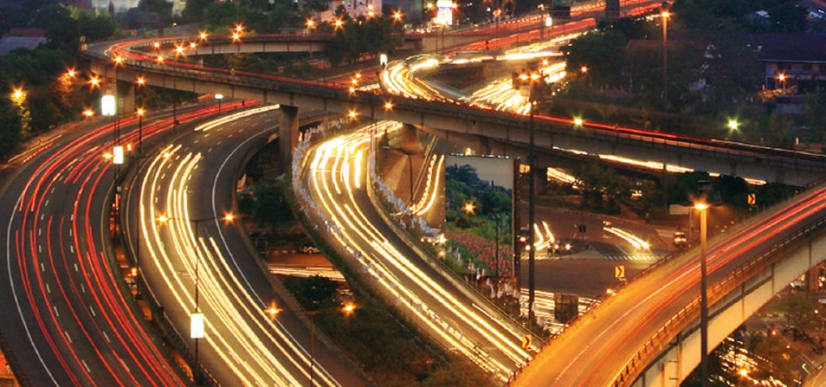
Resources/Tools
Safe/Defensive Driver Trainings
  Check with your insurance broker or carrier to see if they have a Learning Management System available for you to assign online training modules to employees
  Savings from $5k-$10k
Telematics Programs
Notes:
Sara Gibson slide

Slide 28

Provided by:
Notes:
Sara Gibson slide

